Slide 1



Development of a Reinforcement Learning Based Thermal Comfort Controller
GEC Members
Dr Muhammad Sajid
Dr Usman Ali
Research scholar: Ali Hassan Bhatti- MS EE AIAS – SEECS- 2022
Supervisor: Dr. Latif Anjum Co-Supervisor: Dr. Khawaja Fahad

Slide 2
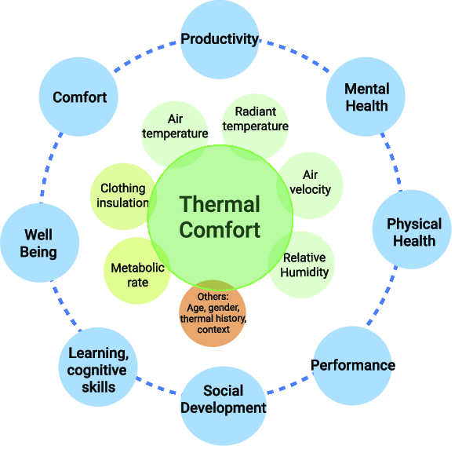
Introduction
﻿90% of our lives are spent indoors
- Thermal Comfort -> Productivity
- Thermal Comfort -> Health
HVAC accounts for around 40%-60% of energy use.
For comfort to be maintained:
Heat Generated
Heat Lost
Lala, B., & Hagishima, A. (2022). A Review of Thermal Comfort in Primary Schools and Future Challenges in Machine Learning Based Prediction for Children. Buildings, 12(11), 2007.
Notes:
﻿90% of our lives are spent indoors either in offices or at our homes
HVAC accounts for around 40%-60% of energy use. Depending upon countries with extremely hot or cold climates.
﻿Thermal comfort is maintained by heat/mass transfer
Human body generates heat (about 100 W under sedentary conditions with body area = 1.5 to 2 m^2)
- For comfort to be maintained:
• Heat flow rate is proportional to temperature difference which is affected by clothing
More layers of clothing=more insulation= less heat loss
More activity = More heat generated

Slide 3
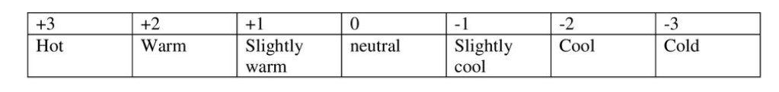
PMV based vs Adaptive Thermal Comfort
The PMV index predicts the mean response of a large group of people on a 7-point thermal sensation scale, from +3 (hot) to -3 (cold), where 0 is neutral.
The Adaptive Thermal Comfort metric relates indoor design temperatures to outdoor temperatures. It is based on the understanding that occupants can adapt to, or even prefer a wider range of conditions.
Auliciems, Andris, and Steven V. Szokolay. "Thermal comfort." sl: PLEA, 1997.
Notes:
We are not robots. We interact with the environment actively and try to go to comfort via behaviourle adaptation like changing clothing metabolic rate etctec. Even when PMV predicts 0 10% people are still uncomfortable. 2 out of 6 parameters used in PMV can not be measured but assumed

Slide 4
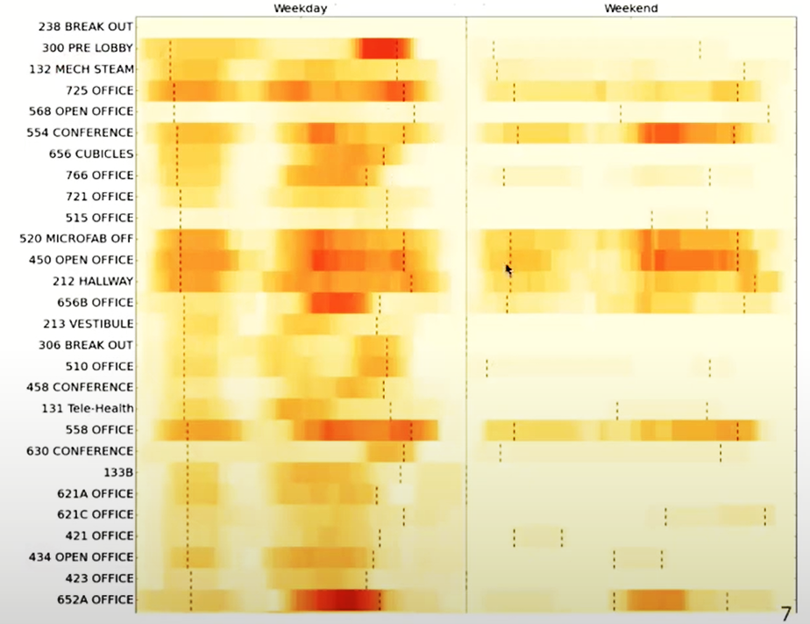
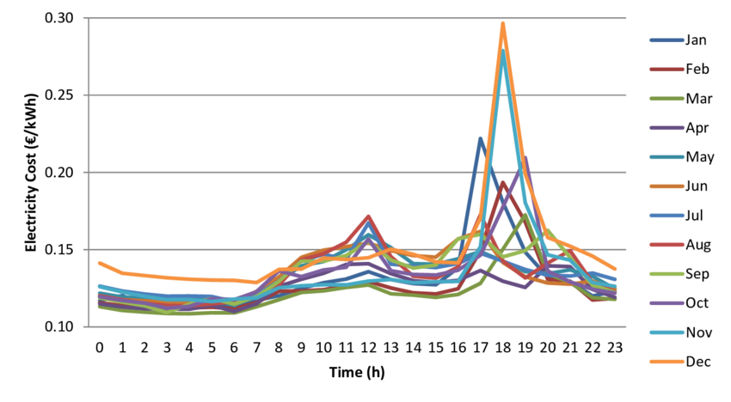
Some other Factors
Predicting the Occupancy and Sleeping patterns to optimize the energy.
Electricity Pricing Peak Hours
Upton, J., Murphy, M. D., Koerkamp, P. W. G., Shalloo, L., & De Boer, I. J. (2014). Strategies to reduce energy use in dairy milking facilities. In 2014 Montreal, Quebec Canada July 13–July 16, 2014 (p. 1). American Society of Agricultural and Biological Engineers.
Notes:
We are not robots. We interact with the environment actively and try to go to comfort via behaviourle adaptation like changing clothing metabolic rate etctec. Even when PMV predicts 0 10% people are still uncomfortable. 2 out of 6 parameters used in PMV can not be measured but assumed

Slide 5


Problem Statement
Current adaptive comfort methods lack adaptability to weather, occupants, and consume excess energy, posing an eco-unfriendly challenge.
The aim is to build an efficient model free RL based thermal comfort controller for simulated house that optimizes for energy use.
Learning a RL control policy through interactions with a simulated environment
Objectives

Slide 6
Why Reinforcement Learning
Existing Controllers: Rule based and Model Based controllers.
Low Computational Cost*
Adaptable
Model Free
Stochastic Dynamics
The way we learn things
Kaelbling, Leslie Pack, Michael L. Littman, and Andrew W. Moore. "Reinforcement learning: A survey." Journal of artificial intelligence research 4 (1996): 237-285.
Notes:
Thus, RL is an extremely valuable tool to find (near-)optimal controllers for nonlinear stochastic systems, in cases when the dynamics are either unknown or affected by significant uncertainty. ote that AI researchers use the name “model-based RL” for algorithms that learn a model from data (effectively performing system identification) and then derive their solution partly using this model. Here, to avoid confusion we call these methods model-learning, while still classifying them as RL, and we reserve the model-based term only for approaches that employ a model from the start. Stcohastic Dynamics include hour of the day, energy consumption, electricity pricing.

Slide 7
Literature Review
Literature Review
Reinforcement Learning
Thermal Comfort
Controllers
Software/tools

Slide 8
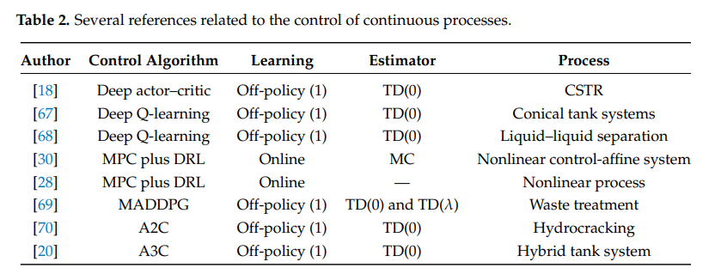
RL a better solution to control problems
RL
RTO
MPC
Faria, R. D. R., Capron, B. D. O., Secchi, A. R., & de Souza Jr, M. B. (2022). Where Reinforcement Learning Meets Process Control: Review and Guidelines. Processes, 10(11), 2311.
Notes:
RL has low computational cost after training and because other relies in complex models and doesn’t consider model mismatch

Slide 9
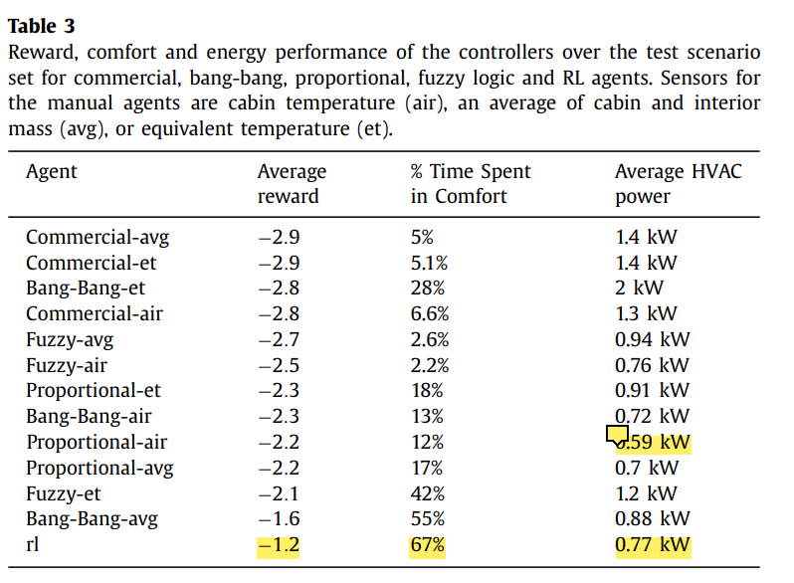
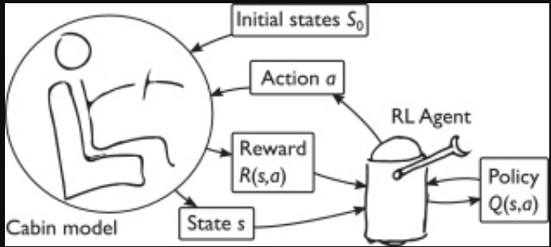
Thermal Comfort for Car Cabin
MDP Solved Using Sarsa
Tested in 200 Scenarios
37% Reduction in Energy Consumption
Surpassed other controllers in performance and energy conservation
Brusey, James, et al. "Reinforcement learning-based thermal comfort control for vehicle cabins." Mechatronics 50 (2018): 413-421.
Notes:
We formulate the cabin comfort control problem (Fig. 1) as a Markov Decision Process (MDP). The air flow corresponding to the cabin occupant �˙� is not directly available and it is estimated here by dividing the vent air flow v_{i} by 10. The value was selected based on cabin air flow measurements in the literature Neacsu [28]. The mean radiant temperature T_{r} is assumed to be equal to the interior mass temperature T_{m}. For this work, the clothing insulation I_{cl} is set to a constant value of 0.7 clo corresponding to long trousers and short sleeve, light-coloured blouse or shirt. Note that ET is provided as input to the ‘et’ variants of the hand-coded controllers but is not explicitly provided to the RL controller. Actions recirculation flap, vent temperature and vent air flows

Slide 10
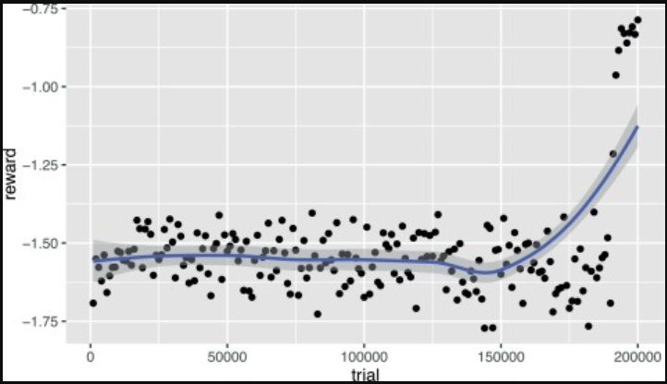
Thermal Comfort for Car Cabin
State: Air cabin temperature, interior mass temperature and outside air temperature
Action: Recirculation flap, Vent temperature and Vent air flows
Reward: Time spent in comfort, Energy Cost
Brusey, James, et al. "Reinforcement learning-based thermal comfort control for vehicle cabins." Mechatronics 50 (2018): 413-421.
Notes:
We formulate the cabin comfort control problem (Fig. 1) as a Markov Decision Process (MDP). The air flow corresponding to the cabin occupant �˙� is not directly available and it is estimated here by dividing the vent air flow v_{i} by 10. The value was selected based on cabin air flow measurements in the literature Neacsu [28]. The mean radiant temperature T_{r} is assumed to be equal to the interior mass temperature T_{m}. For this work, the clothing insulation I_{cl} is set to a constant value of 0.7 clo corresponding to long trousers and short sleeve, light-coloured blouse or shirt. Note that ET is provided as input to the ‘et’ variants of the hand-coded controllers but is not explicitly provided to the RL controller. Actions recirculation flap, vent temperature and vent air flows

Slide 11
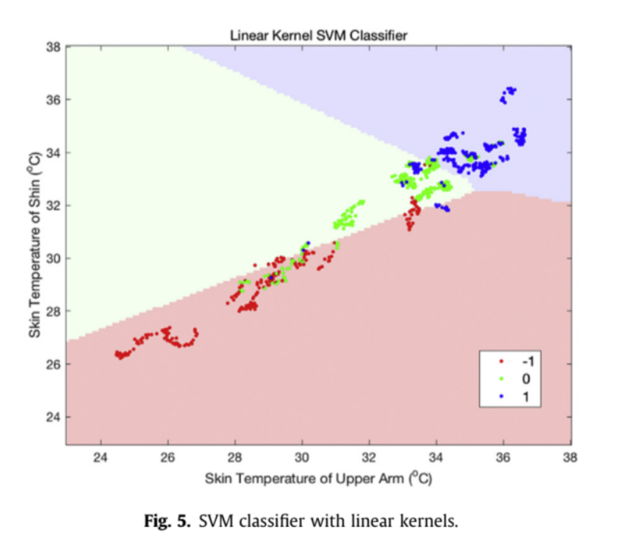
Thermal Demand
Using a single skin temperature correctly predicts 80% of thermal demands. Results show that three skin locations contained enough information for classification and more would cause the curse of dimensionality.
Dai, Changzhi, et al. "Machine learning approaches to predict thermal demands using skin temperatures: Steady-state conditions." Building and Environment 114 (2017): 1-10.

Slide 12
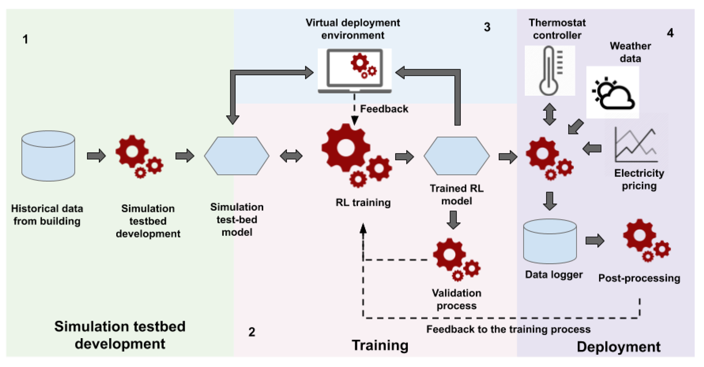
Employing pre-trained DRL Model
30% of cost reduction and 21% in real house
Kurte, Kuldeep, et al. "Evaluating the adaptability of reinforcement learning based HVAC control for residential houses." Sustainability 12.18 (2020): 7727.
Notes:
Trained the agent on single building and tested on multiple buildings with different dynamics

Slide 13



Methodology Overview
Expected Outcomes
Optimal Thermal Comfort
Energy Efficiency
Adaptability
Outputs
On-Off for AC or State change between heating and cooling
Next State
Reward
Action
Objective
Learning the RL Control Policy
Relevant Datasets
Knoxville, USA
2- Zone single Family House
Indoor Temperature
Outdoor Temperature
Electricity Pricing
Weather Data
Simulated House Environment
Disturbances
Number of persons
Inside temperature
Outside temperature
Energy Consumption
Electricity Pricing
Kurte, Kuldeep, et al. "Evaluating the adaptability of reinforcement learning based HVAC control for residential houses." Sustainability 12.18 (2020): 7727.
Notes:
We will merge sleeping patterns and occupany as these are independent on other factors and depends on season. We will assume season based occupany and sleeping patterns.

Slide 14
Methodology Overview
Next State
States
Indoor Temperature
Outdoor temperature
Number of occupants
Hour of the day
Weather data
Energy Cost
Energy Utilized
Reward
Action
Actions
Provide Heating or cooling
Simulated House Environment
Notes:
Trahing with data and testing in the simulated environment. Both data and environment are linked as we need to provide the same triggers or states in the environment on which the RL agent was trained

Slide 15
Research Plan | August |  |  |  | September |  |  |  | October |  |  |  | November |  |  |  | December |  |  |  | January |  |  |  | February |  |  |  | March |  |  |  | April |  |  |  | May
Literature Review
CFD/Environment Setup
Exploring Historical Datasets
RL Control
Training/Testing
Documentation

Slide 16
Progress
Software/Tools
CFD
HVAC
3D Environments
HVAC
Programming and Control
Hourly Energy Program
Programming and Control
Open AI Gym
Ansys Workbench
Openfoam
Energy Plus
Gazebo
Simpy
MATLAB
Python Packages

Slide 17
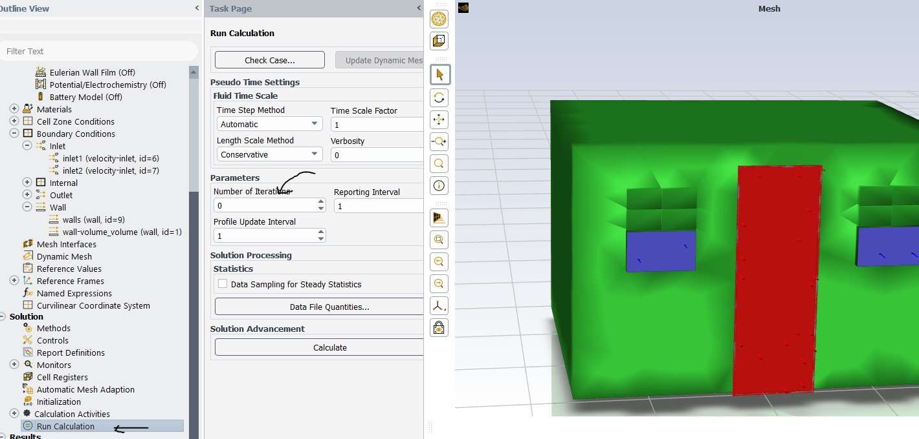
Progress

Slide 18
Novelty
Sleeping patterns
Occupancy based control via RL
Adaptive thermal comfort considering weather conditions
Minimal Energy Consumption

Slide 19
Conclusion
Proposed Solution: RL-Based Controller for energy efficient Thermal Comfort control for simulated house.
Research Collaboration: Coventry University, UK, and NUST, Pakistan.
Impact: Optimal Energy consumption worldwide. Can reduce tons of CO2 emission. Save Resources, enhance Adaptability and sustainability.

Slide 20
Questions raised in previous PD
What is difference between RL control policy and simple control policy?
What is optimization in controls?
Why RL over PMV control?
Why we cannot perform training actual environment?

Slide 21
References
Fanger, P. O. (1970). Thermal Comfort: Analysis and Applications in Environmental Engineering. Danish Technical Press.
Guo, H., Simon, M. P., & Fischbeck, P. S. (2017). Comparison of Residential Heating and Cooling Energy Consumption to Energy Code Requirements in the United States. Energy and Buildings, 144, 81-91.
Sutton, R. S., & Barto, A. G. (1998). Reinforcement Learning: An Introduction. MIT Press.
Schulman, J., Wolski, F., Dhariwal, P., Radford, A., & Klimov, O. (2017). Proximal Policy Optimization Algorithms. arXiv preprint arXiv:1707.06347.
Yao, R., Li, B., & Steemers, K. (2005). A Review of Climate‐Responsive Building Design. Building and Environment, 40(11), 1457-1476.
Schaut, Stefan, and Oliver Sawodny. "Thermal management for the cabin of a battery electric vehicle considering passengers’ comfort." IEEE Transactions on Control Systems Technology 28.4 (2019): 1476-1492.
Brusey, James, et al. "Reinforcement learning-based thermal comfort control for vehicle cabins." Mechatronics 50 (2018): 413-421.
Kurte, Kuldeep, et al. "Evaluating the adaptability of reinforcement learning based HVAC control for residential houses." Sustainability 12.18 (2020): 7727.
Liang, Jian, and Ruxu Du. "Thermal comfort control based on neural network for HVAC application." Proceedings of 2005 IEEE Conference on Control Applications, 2005. CCA 2005.. IEEE, 2005.

Slide 22
References
Ngarambe, Jack, Geun Young Yun, and Mat Santamouris. "The use of artificial intelligence (AI) methods in the prediction of thermal comfort in buildings: Energy implications of AI-based thermal comfort controls." Energy and Buildings 211 (2020): 109807.
Castilla, M., et al. "A comparison of thermal comfort predictive control strategies." Energy and buildings 43.10 (2011): 2737-2746.
Liang, Jian, and Ruxu Du. "Thermal comfort control based on neural network for HVAC application." Proceedings of 2005 IEEE Conference on Control Applications, 2005. CCA 2005.. IEEE, 2005.
Castilla, M., et al. "Thermal comfort control using a non-linear MPC strategy: A real case of study in a bioclimatic building." Journal of Process Control 24.6 (2014): 703-713.
Kim, Joyce, Stefano Schiavon, and Gail Brager. "Personal comfort models–A new paradigm in thermal comfort for occupant-centric environmental control." Building and Environment 132 (2018): 114-124.
Abdulgader, Musbah, and Fadel Lashhab. "Energy-efficient thermal comfort control in smart buildings." 2021 IEEE 11th Annual Computing and Communication Workshop and Conference (CCWC). IEEE, 2021.
Brik, Bouziane, et al. "ThermCont: A machine Learning enabled Thermal Comfort Control Tool in a real time." 2019 15th International Wireless Communications & Mobile Computing Conference (IWCMC). IEEE, 2019.

Slide 23
Thanks

Slide 24
Thermal Comfort
Parameters
Environments
Vehicles
Buildings
Models
Climate Parameters
Indoor
Outdoor
Thermal Comfort
Physiological Conditions of person
Physiological Conditions of person
CO₂ Level
Time of the day
CO₂ Level
Clothing Insulation
Others
Temperature
Humidity
Temperature
Djongyang, Noël, René Tchinda, and Donatien Njomo. "Thermal comfort: A review paper." Renewable and sustainable energy reviews 14.9 (2010): 2626-2640.

Slide 25
Why Reinforcement Learning
Existing Controllers: Rule based and Model Based controllers.
Reinforcement learning is the way, we learn things
Adaptability: RL systems can learn and adapt to changing conditions and user preferences over time.
Model Free: Control policies can be learnt directly through data.
Stochastic Dynamics: Reinforcement learning (RL) offers powerful algorithms to search for optimal controllers of systems with nonlinear, possibly stochastic dynamics that are unknown or highly uncertain.
Kaelbling, Leslie Pack, Michael L. Littman, and Andrew W. Moore. "Reinforcement learning: A survey." Journal of artificial intelligence research 4 (1996): 237-285.
Notes:
Thus, RL is an extremely valuable tool to find (near-)optimal controllers for nonlinear stochastic systems, in cases when the dynamics are either unknown or affected by significant uncertainty. ote that AI researchers use the name “model-based RL” for algorithms that learn a model from data (effectively performing system identification) and then derive their solution partly using this model. Here, to avoid confusion we call these methods model-learning, while still classifying them as RL, and we reserve the model-based term only for approaches that employ a model from the start. Stcohastic Dynamics include hour of the day, energy consumption, electricity pricing.

